Slide 1
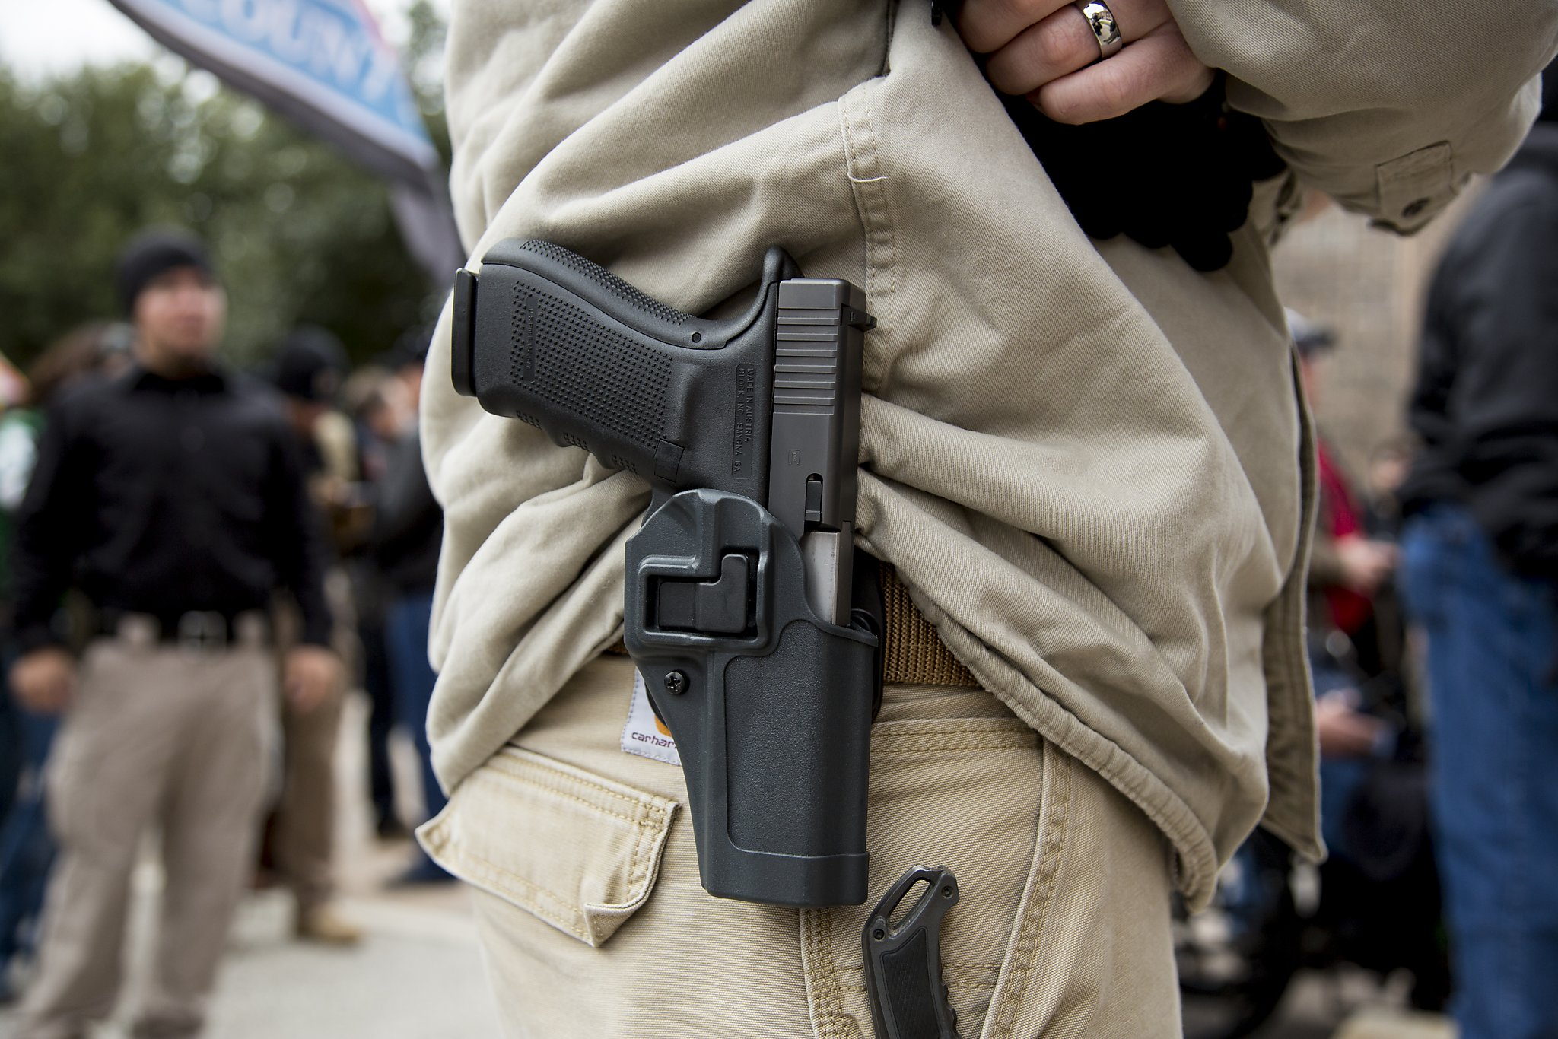

Armed.
Object detection for tyrannical police state protection

Slide 2

The problem
In modern day America nearly 79,000 people are injured annually from gun violence.
Over 40% of those injuries result in fatalities. From mass shootings at concerts to the use
of firearms where the most vulnerable of us learn. The problem of unidentified individuals
entering our most sensitive and sacred places to do harm with firearms is well known and largely
unaddressed.
Armed.
By Xlegic Sin’Austin

Slide 3
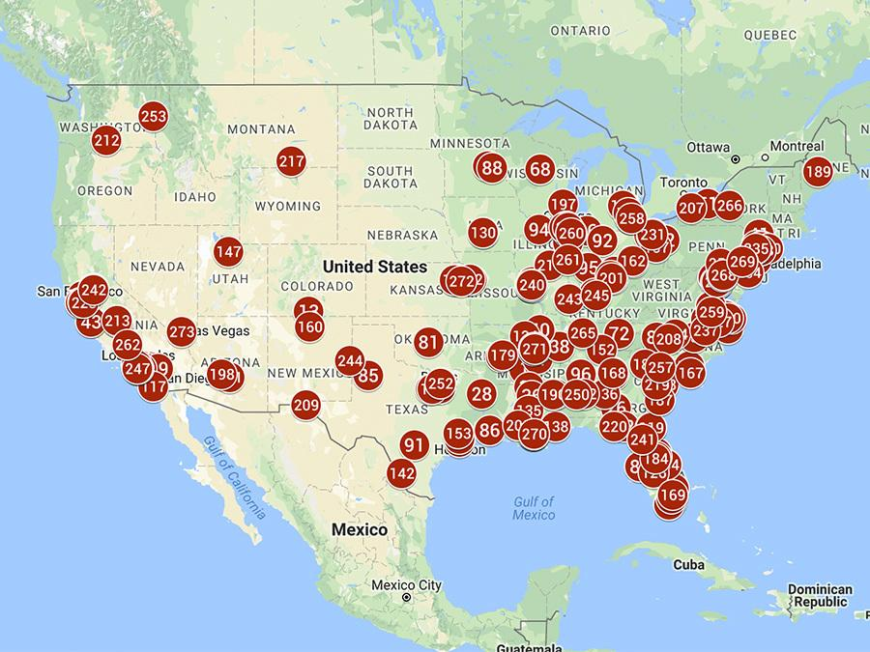
Mass Shootings
2017
Armed.
By Xlegic Sin’Austin

Slide 4
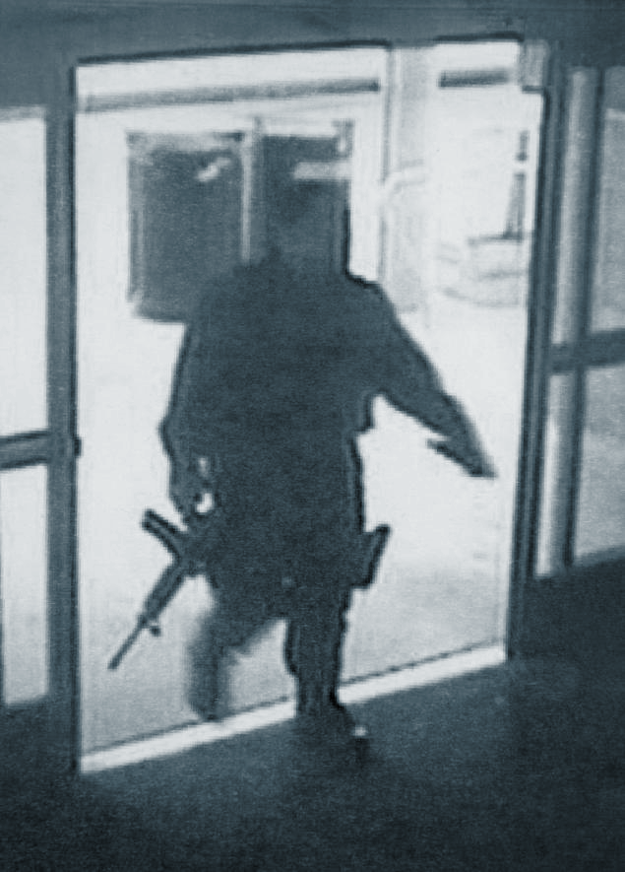
The proposal
The public has no idea that someone with a gun is about to wreak havoc until they hear shots in the air.
Where every second matters, we all wish that someone had seen this terrible act incoming and had locked
a door or given people more time. But usually not one sees or is able to warn people in time. This is were
Armed comes in. I suggest we create an object detection based system that is capable of identifying a weapon
on a person before a person before the a person intending to do harm begins his attempt.
This system could be run on surveillance cameras inside and outside of any building(say a school) an
would alert the individuals inside or even put the location on lockdown if it detects a firearm in a person's
possesion. This project is a base proof of concept for the object detection portion of such a system.
Armed.
By Xlegic Sin’Austin

Slide 5



Evaluate
Train and Test
My process
Obtain the data
Find a model
Learn about object detection
Armed.
By Xlegic Sin’Austin

Slide 6
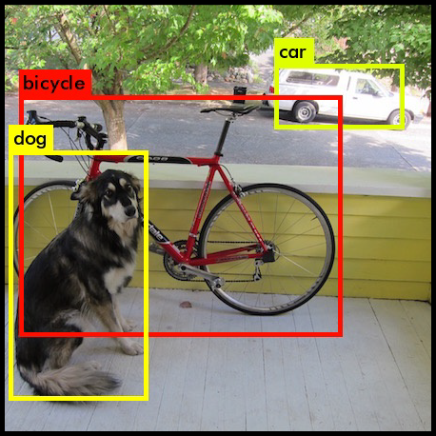
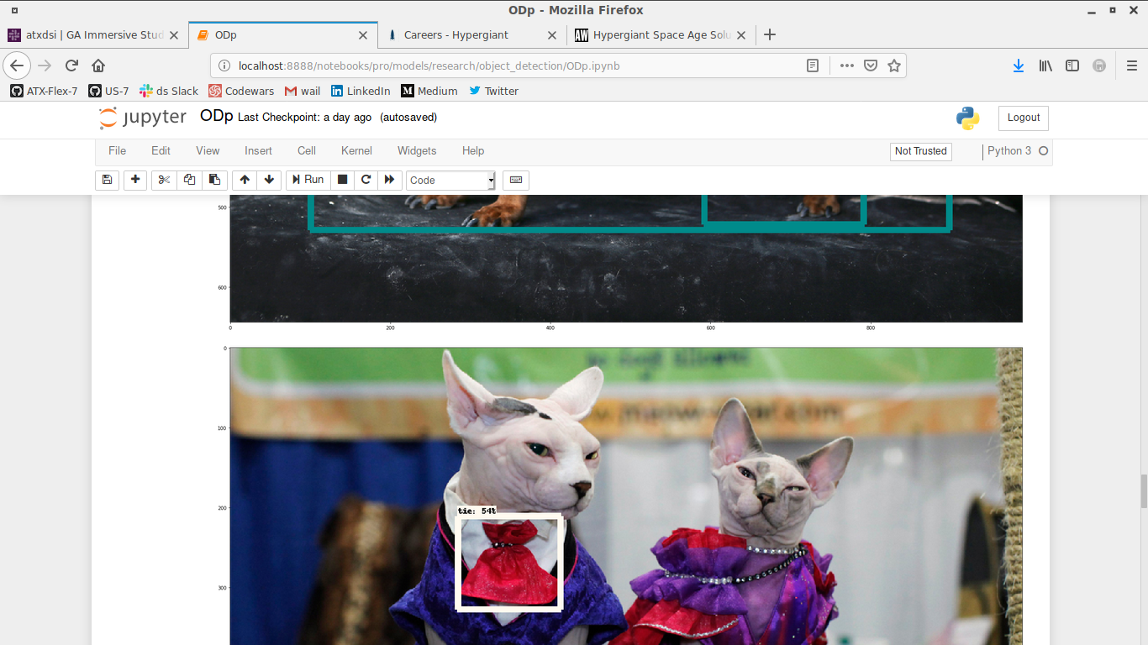
Learning about object detection
I used tensorflow tutorials
And yolo as my introduction
to object detection.
Armed.
By Xlegic Sin’Austin

Slide 7
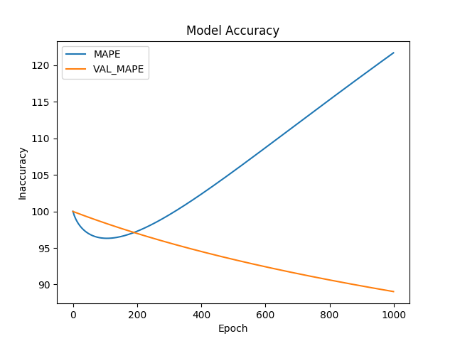
Find A Model
I initially planned on creating a fully custom model
instead of using some of the premade TF models.
The decision to use a premade tensorflow model
was easy once I compared the lose between the two.
The main qualities I wanted in a model were speed
and a lighter weight. In the end i went with the ssd_mobilenet model.
Armed.
By Xlegic Sin’Austin

Slide 8
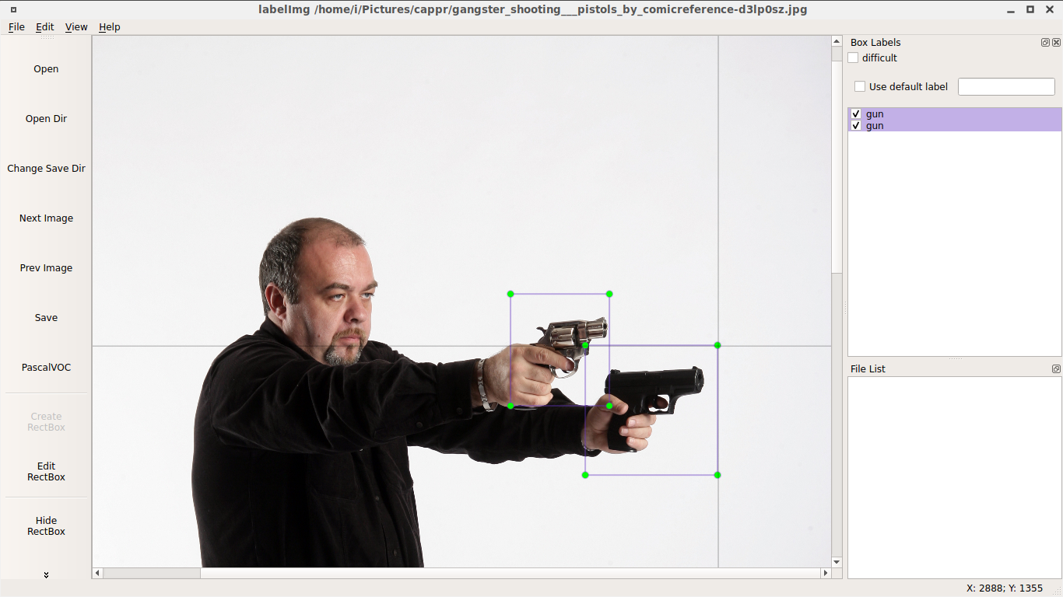
Obtain the data
Images
Search Engines
Free to use movies and videos
Personally made data for less common angles
Modifications
Target Locating using bounding boxes(LabelImg)
Armed.
By Xlegic Sin’Austin

Slide 9
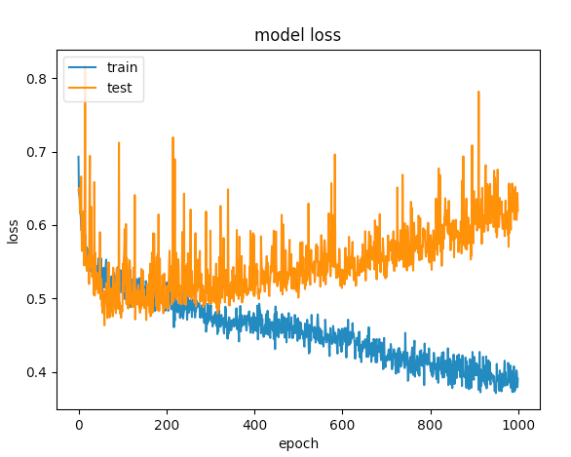
Training
I attempted to ensure that the train set didn't have too many instances of very similar angle.
Put a real whoopin on my cpu
Will use AWS first on the next training interval
Armed.
By Xlegic Sin’Austin

Slide 10
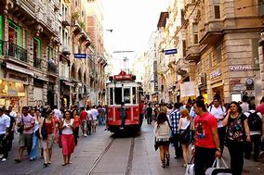

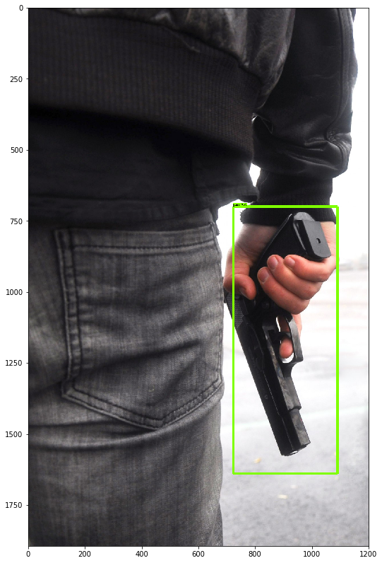
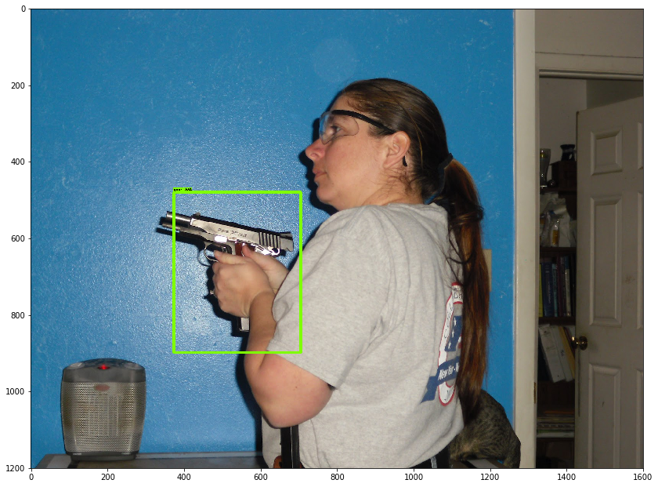
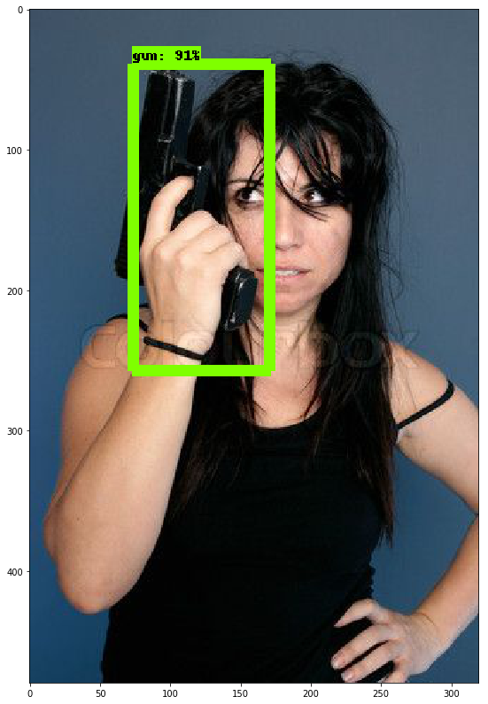
Testing on Images
Armed.
By Xlegic Sin’Austin

Slide 11
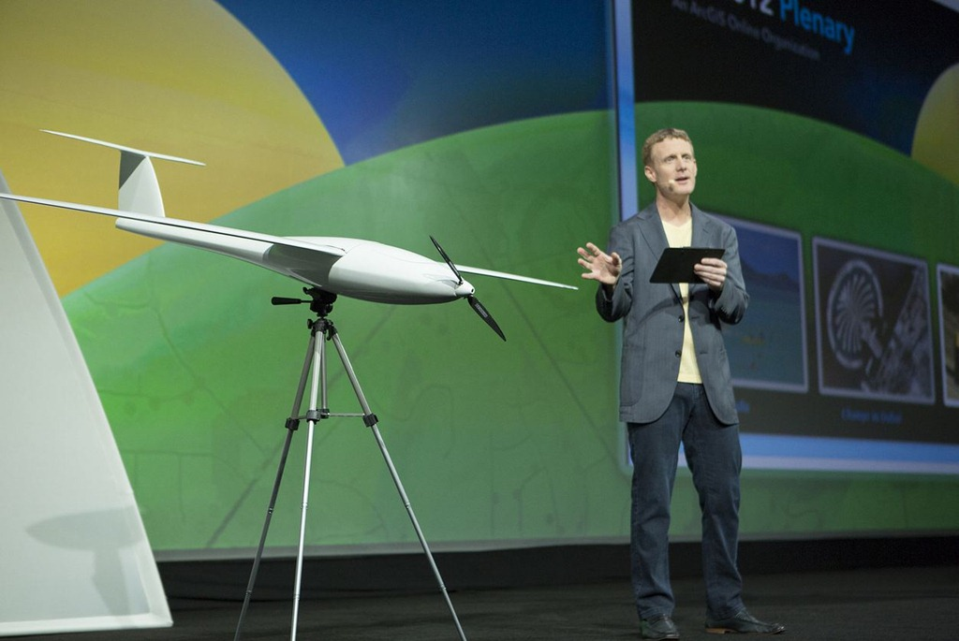

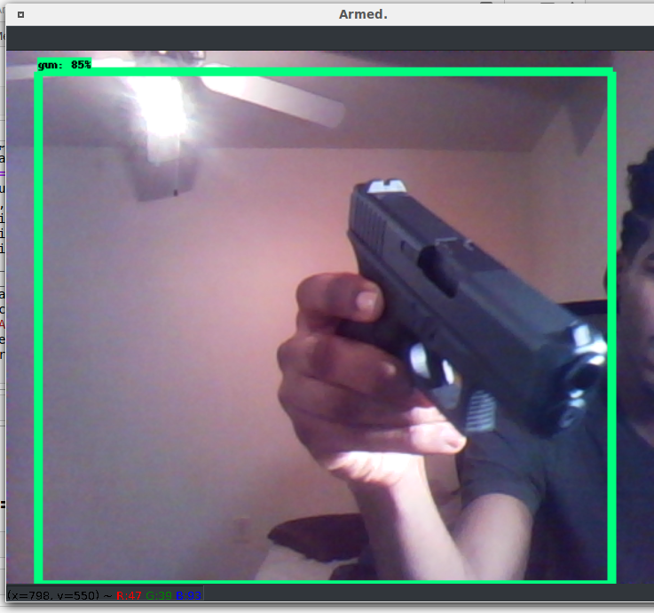
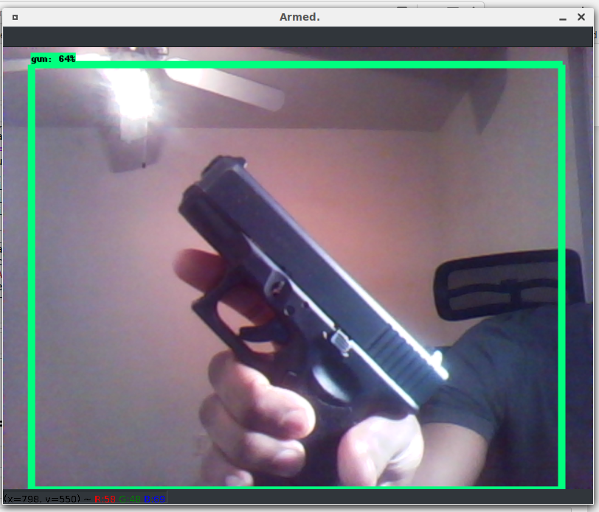
Testing on a live camera
The model identified the firearm Live and in different lighting settings!
This is positive confirmation that a model can be trained to identify a firearm and could play integral part in a security system.
Armed.
By Xlegic Sin’Austin

Slide 12
Evaluation
This project shows that object detection of firearms works and given stronger hardware and more training data a model could be a viable way to protect the people we care about. A system like this could see a person with harmful intent coming and put building on lock down, giving him no way to enter. Imagine the lives that would have been saved if the gunman couldn’t have could have opened the door.
The next steps in this project would be more training on security footage while considering ethical changes and training. Then the build-out of a popup and warning system.
Armed.
By Xlegic Sin’Austin

Slide 13








Some of the skills and programs used.
Armed.
By Xlegic Sin’Austin

Slide 14

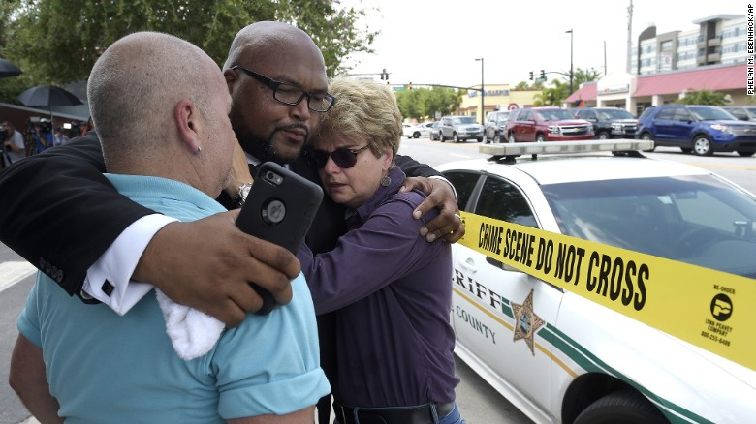
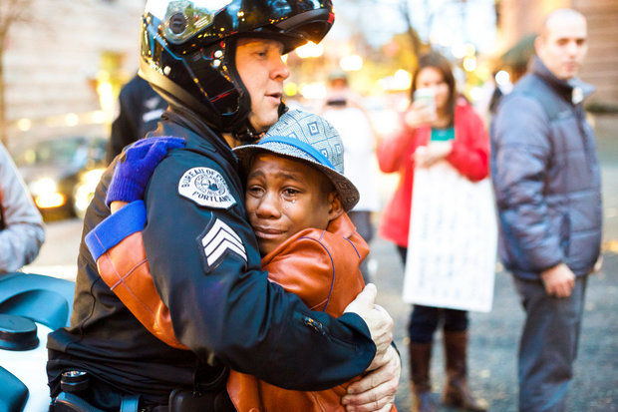
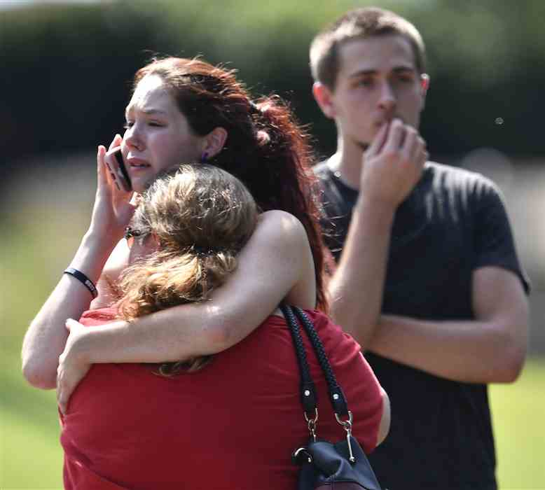

Thank You
Armed.
By Xlegic Sin’Austin

